Slide 1
ImageRights Gemini vs. Google Reverse Image Search
To support its copyright enforcement objectives, ImageRights performs more targeted and more comprehensive crawls of websites than Google.
ImageRights finds many highly relevant image uses that Google does not:
Background images
Images used within an online advertisement
Heavily cropped, rotated or manipulated images
Composite images.
In October 2016 we ran an internal analysis of our Gemini search results versus Google search results and found that 89.4% of the sightings that the ImageRights Gemini crawler found were not reported by Google reverse image search.
ImageRights International, Inc. – Proprietary & Confidential

Slide 2
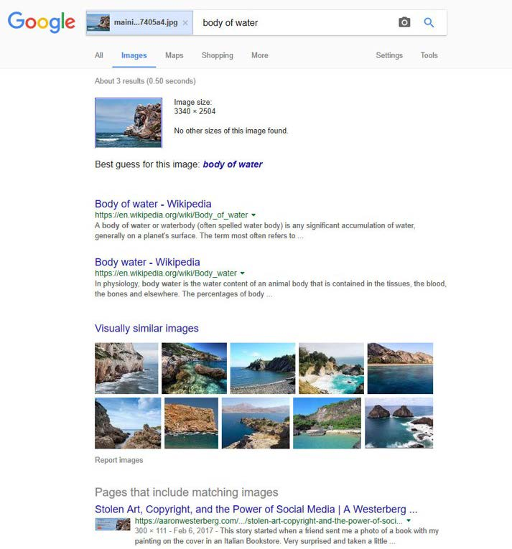
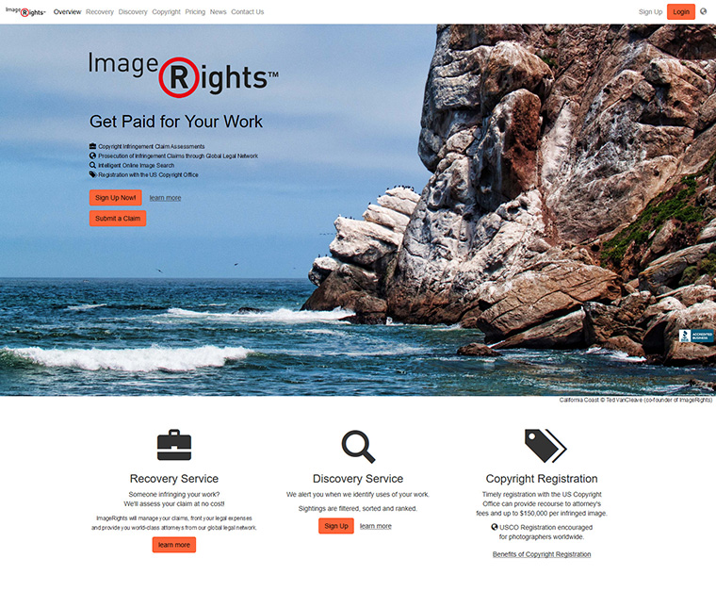
Example of Google Not Finding a Background Image
Google reverse image search does not report embedded background images, like the image on the ImageRights home page.
The exact same file as stored on our web server is used for a Google search.
ImageRights.com is not found.
ImageRights International, Inc. – Proprietary & Confidential

Slide 3
ImageRights Gemini Finds the Background Image that Google Doesn’t
The Gemini crawler, in contrast, does analyze background images. And it can identify exact and modified copies of the source image. In this example, the image has been flipped, cropped and resized.
Original image
Flipped, cropped and resized version
Sighting as Reported by ImageRights
ImageRights International, Inc. – Proprietary & Confidential

Slide 4
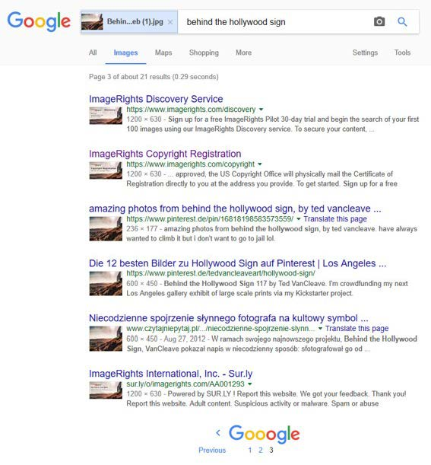
Example of Google Prioritizing Social Media Images
Interestingly, Google’s reverse image search engine will report sightings based solely on the og:image header social media meta tag, even if that image is not present on the page.
Searching Google for:
produces a false positive.
The ImageRights Copyright Registration webpage clearly doesn’t show the image:
ImageRights International, Inc. – Proprietary & Confidential

